Slide 1
MYTHICAL CREATURES
And their routes around our campus
By: Charan Yakkanti, Nitin Chandrasekhar, Govind Menon

Slide 2
INTRODUCTION
Our mythical creatures pulling many carriages are very tired due to their long routes around campus
To help our creatures out, we created a spell that helps optimize their routes

Slide 3
01
Extracting Their Transit Points

Slide 4
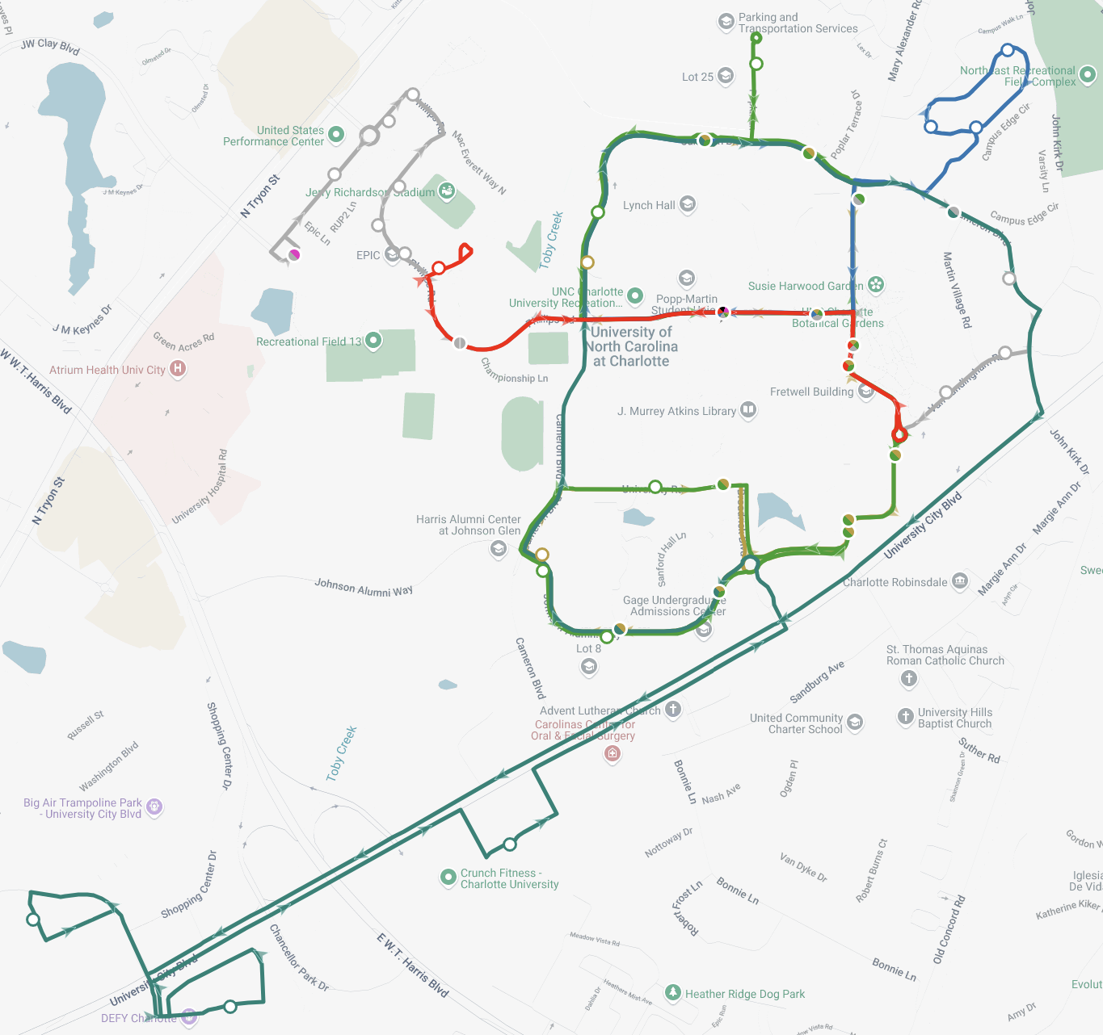
Their Travel Route
Using “Passio GO!” API, we extracted the coordinates for all route stops for all the creatures.
Plotted the route stops onto a map according to the coordinate data and sorted them according to route colors.

Slide 5
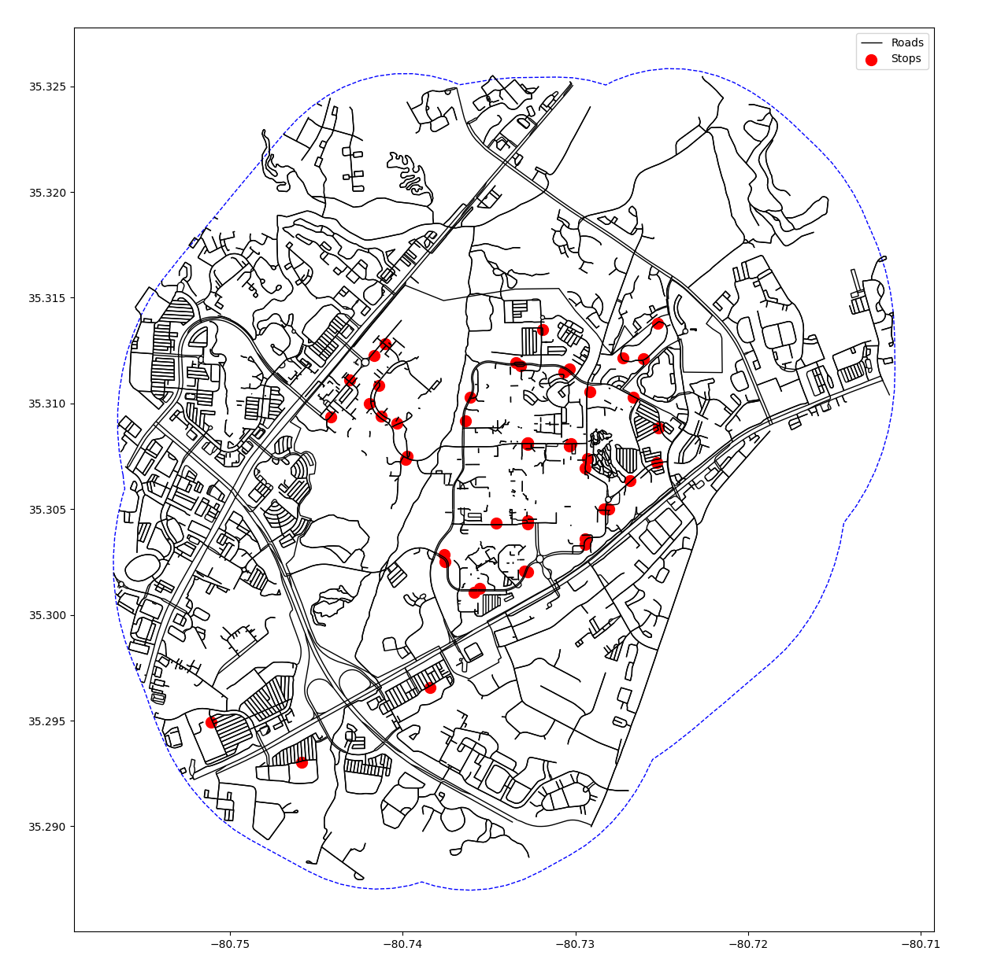
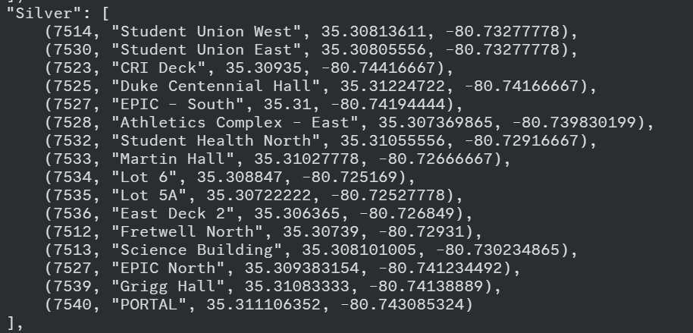

Slide 6
02
Working the Magic of Optimization

Slide 7
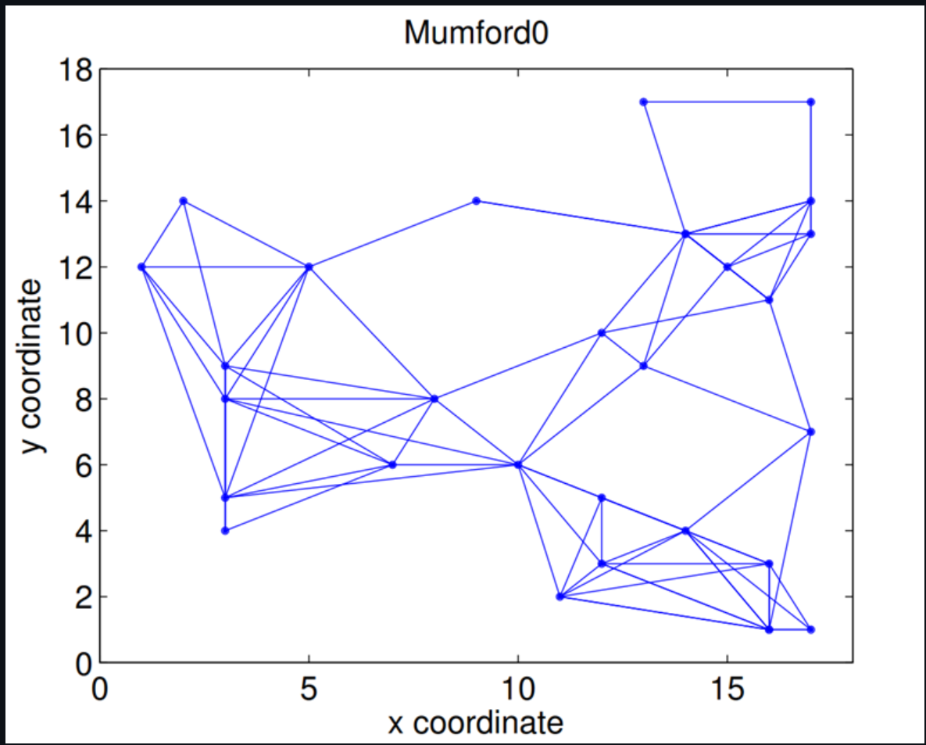
Mechanics Behind the Magic
Research
We searched through for various searching and optimization magics
Some examples include the Mumford model as seen to the right

Slide 8
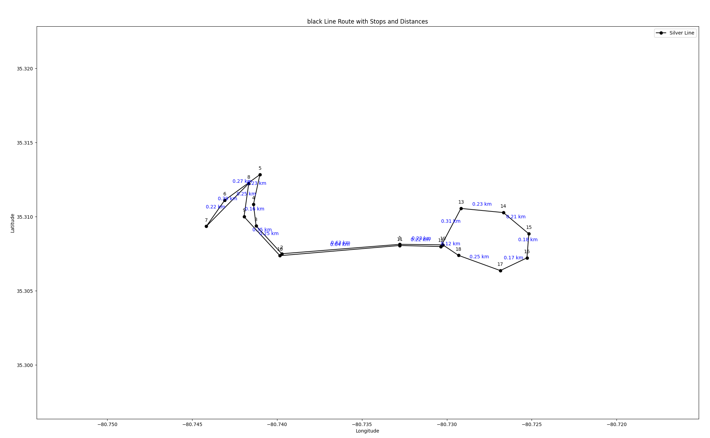
Mechanics Behind the Magic
Distance Optimization
Devised an algorithm that calculates distances between 2 concurrent nodes.
This is the result of only the Sylvester route

Slide 9
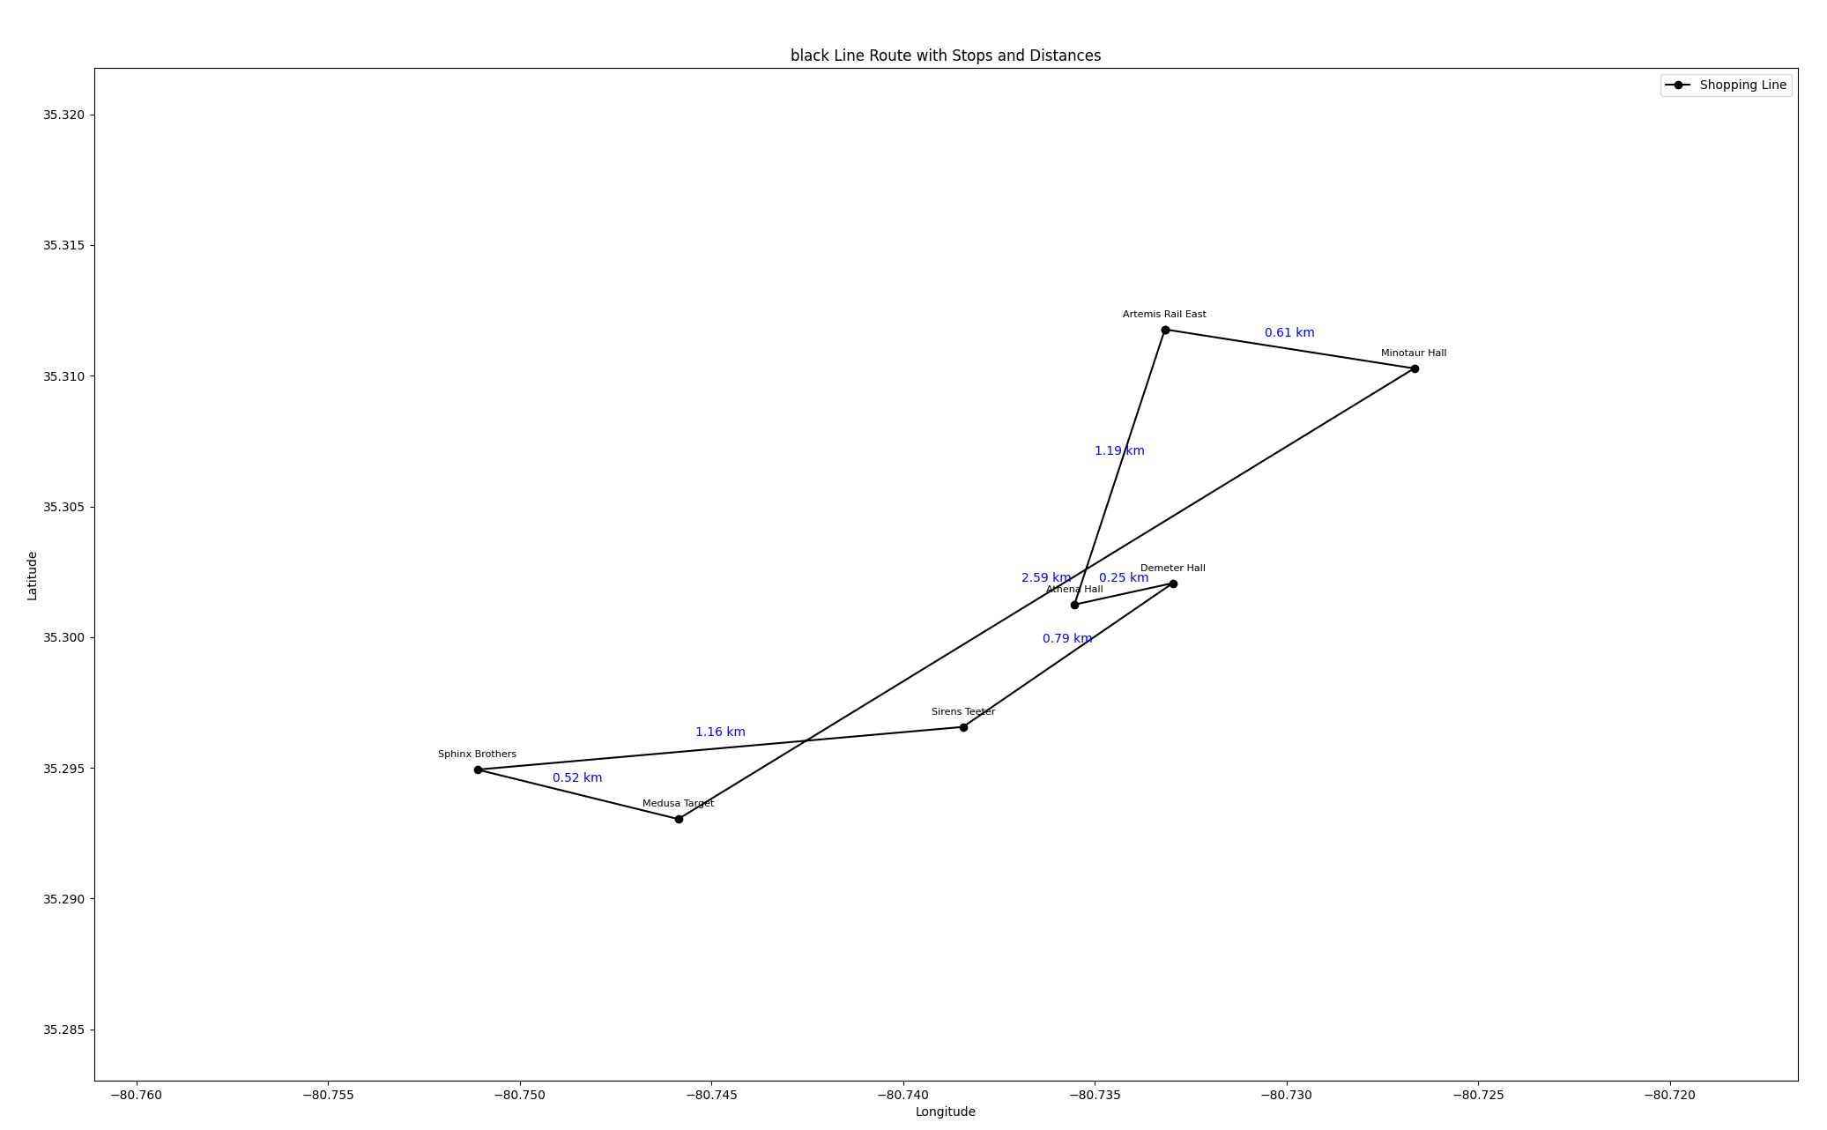
Mechanics Behind the Magic
Plotting the Graph
Expanded on the plot algorithm to include all important routes
This was our final product

Slide 10
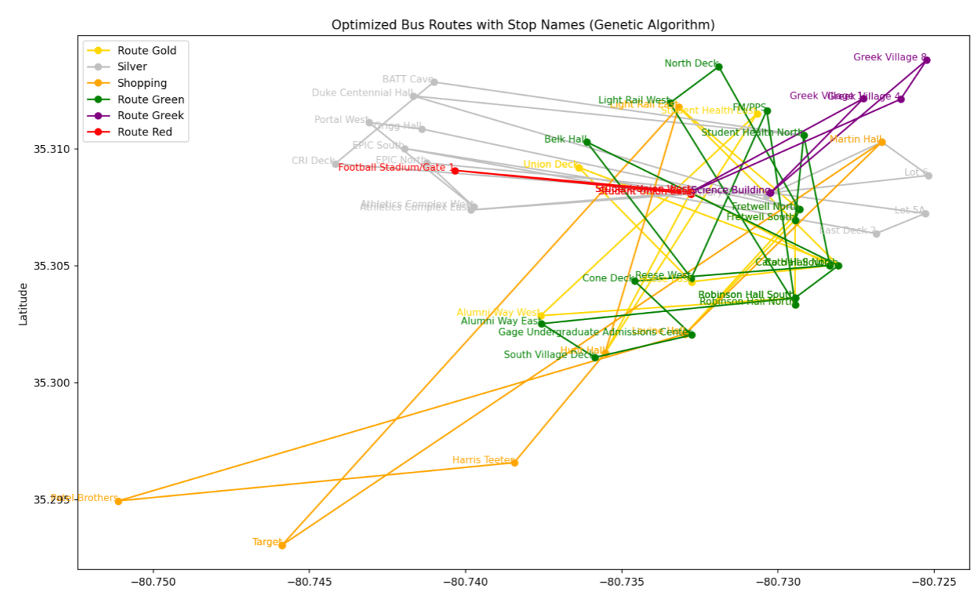
Some Magical Malfunctions
Nickname: Cell Mitosis

Slide 11
Future Plans
Make it more flexible across other campuses
Better projection of the maps
Use a GUI to make it more user-friendly

Slide 12
Thank You

